Slide 1
Rockbuster Stealth LLC
A movie rental company
data analytics for stratplan 2020
Project owner: Emin cerit
emincerit@gmx.at

Slide 2
Introduction
Rockbuster Stealth LLC is a movie rental company that used to have stores around the world. Facing stiff competition from streaming services such as Netflix and Amazon Prime, the Rockbuster Stealth management team is planning to use its existing movie licenses to launch an online video rental service in order to stay competitive.
Analyzing Rockbuster’s Data provides insights to find answers for following Business Questions:

Slide 3
Business Questions
Do sales figures vary between geographic regions?
Which countries are Rockbuster customers based in?
How many customers in Top 10 cities within the top 10 countries?
Who are the Top 5 customers in the Top 10 cities paid highest amounts?
What was the average rental duration and rental rate for all videos?

Slide 4
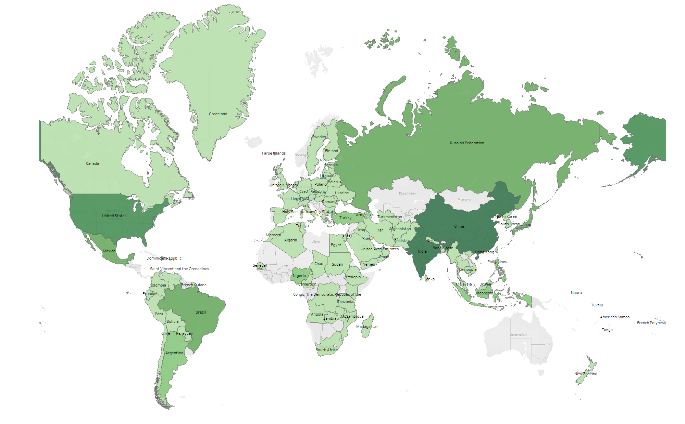

Do Sales Figures vary between geographic regions?
Total Global Sales:
61.312 USD in 2019
in 108 Countries
Highest Sales were made
in Asia followed by
North America.

Slide 5
Which countries are Rockbuster customers based in?
Count of Customers:
Total: 599
Top 10 Countries: 315
Ratio: 53%

Slide 6
How many customers in Top 10 cities within the top 10 countries?
Count of Customers:
Total: 599
Top 10 Cities: 11

Slide 7
Who are the Top 5 customers in the Top 10 cities paid highest amounts and their paid average?
Avg. amount: 107,15 USD
First Name | Last Name | City | Country | USD
Sara | Perry | Atlixco | Mexico | 128.70
Gabriel | Harder | Sivas | Turkey | 108.75
Sergio | Stanfield | Celaya | Mexico | 102.76
Clinton | Buford | Aurora | United States | 98.76
Adam | Gooch | Adoni | India | 97.8

Slide 8
What was the average rental duration and rental rate for all videos by rating?
Duration
Rental Rate

Slide 9
Insights and Recommendations
Highest Sales were made in Asia and North America, where in parallel we can recognize, that these regions also have the most customers.
Only 10 countries out 108 are representing 53% of total customers (315/599). What about the other 98 countries? Requires further analysis (e.g., film category, rating, sales development,…)
For the customers of higher sales regions, a marketing campaign can be started with special bonus offerings as kind of saying thank you for their loyalty.
Regions with lower sales, incentives for the existing customers can be an option like granting them 10 movies for free for refereeing a new customer to increase the number of customers.
Interesting point is, that 3 of the top 5 customers in the top 10 cities are coming from countries with mid level sales and not from India, China or U.S. Their payment amount is higher than 100 USD. Futher analysis of their profile could bring more insights.
The rental rates are almost on the same level for all ratings. A differentiation of the rates per rating could have potential to gain more revenue. NC-17 film rates should be most expensive.

Slide 10
TO FIND MORE INSIGHTS CLICK THANKS FOR YOUR ATTENTION
Rockbuster on Tableau
Emin Cerit emincerit@gmx.at

Slide 11


